Slide 1
Psychological Aspects of Divorce
Christine M Heer, Esq. MSW, LCSW, DVS

Slide 2
Marriage

Slide 3
Big wedding

Slide 4
Family

Slide 5
Until they didn’t!

Slide 6
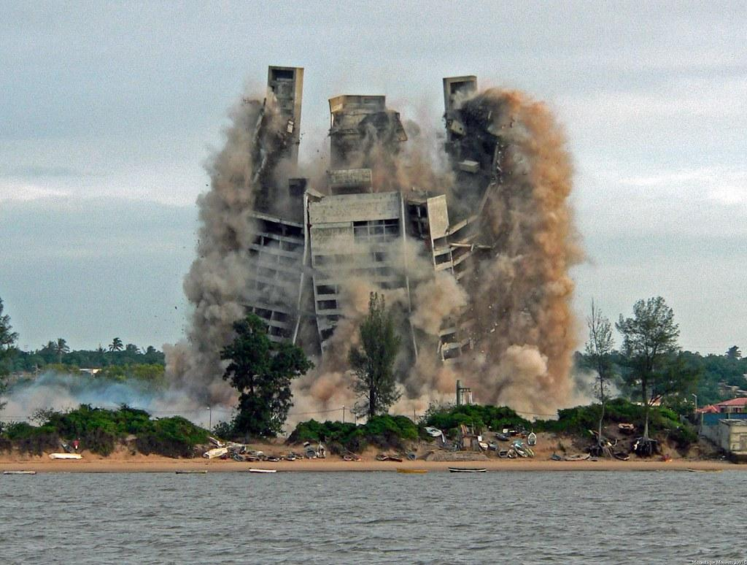
Dreams, hopes, identity, expectations
IMPLODES

Slide 7
Poll https://forms.office.com/Pages/ResponsePage.aspx?id=InzwUbdT30S5fKEyYdcQdcUPXnrckppMlguX7Pmng3RUNzdKSllIUVpRUzlSQjdRNVFUS0gxNkNNRC4u

Slide 8
Why Divorce?
Infidelity
Inability to resolve conflict
Not ready to marry: Immature
How the partner expresses love/intimacy
Lack of commitment
Personality

Slide 9
Splitting Up: Divorce, Culture, and the Search for a Real Life by Larry Frolick
Expectations of Childhood unmet
Changing Roles of Women
Social Environmental changes
Incompatible
Normative Expectations and Need
Social Plague
Video Clip

Slide 10
The Psychology of Marriage and Divorce
Why you married?
What happened in the marriage?
What the divorce means to you?
Who are you after?

Slide 11
Constance Ahrons: The Good Divorce
Cooperative Colleagues
Perfect Pals
Angry Associates
Fiery Foes

Slide 12
Holmes Rahe Stress Inventory
Divorce and Separation are more stressful than going to prison
Only thing more stressful than death of the spouse.
https://www.stress.org/holmes-rahe-stress-inventory

Slide 13
Cumulative Stress
# of previous stressors in the prior 2-3 years
Role change

Slide 14
Factors that mitigate and aggravate
Who wants the divorce?
Was it a “surprise?”
Contributing factors to the divorce
One or both?
Crazy Time: Surviving Divorce and Building a New Life
by Abigail Trafford
Were signs ignored?
Were there a lot of secrets?
Domestic Violence
Affairs
Substance Use and abuse
Betrayal

Slide 15
Factors that mitigate and aggravate
Mental Illness
Serious Disorders
Personality Disorders
Falling “out of love.”

Slide 16
Role Theory
Role theory refers to the cultural norms regarding psychological and interactional aspects of members of society, such as mothers, fathers, sons, daughters, and grandparents.
Encyclopedia of Applied Psychology (2004)

Slide 17
Divorce and the Impact on Socially Defined Roles
Divorce changes the role of marital partner
Wife
Husband
Caretaker
Breadwinner
Parent
Nurturer

Slide 18
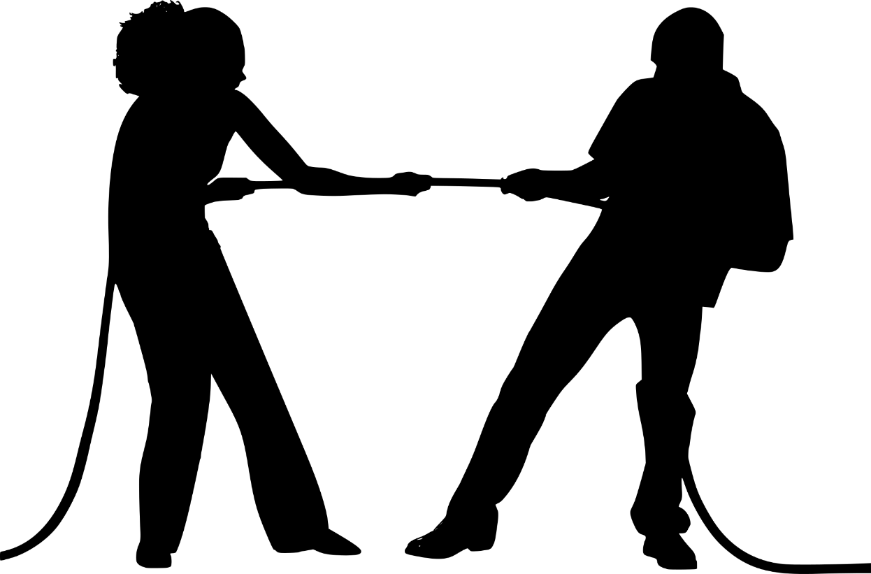
How would threats to role impact Divorce
What are people wanting?
Willing to fight for?
Discussion.
This Photo by Unknown Author is licensed under CC BY

Slide 19
Psychological Theories
CBT
CRISIS THEORY
TRAUMA THEORY
Systems Theory
Change Theory

Slide 20
Cognitive Behavioral Theory
Feelings
Cognitive Distortions
History
Acting Out
Resistance
Violence
Anger
Fear
Sadness
Thoughts
Behavior

Slide 21
Cognitive Distortions

Slide 22
Examples
Discussion

Slide 23
Systems Theory
Early etiological theories of child and marital problems assumed unidirectional cause-effect relationships. That is, it was always presumed that dysfunctional marital relationships caused dysfunctional behavior patterns in children.
In this view, "the family is conceptualized as a cybernetic system in which the actions of each member influence the actions of each other member reciprocally
(Saposnek, 1983b, p. xv.).
Notes:
Structural family therapy models assert that relational interactions become altered by focusing on changing the dysfunctional family structure, whereas strategic family therapy models state that family structure will change organically once the relational strategies become modified.Feb 22, 2017

Slide 24
Structural Family Assessments -Minuchin
(1) opening up the presenting complaint,
(2) highlighting problem-maintaining interactions,
(3) a structurally focused exploration of the past, and
(4) developing a shared vision of pathways to change.
(Minuchin, Nichols, & Lee, 2007)

Slide 25
Trauma Informed
Important for working with adults and children
Work with adults impacts children’s lives
What is trauma?
Activates the Amygdala: Fight, Flight, Freeze, Fidget
ACES: Adverse Childhood Experiences

Slide 26
Transtheoretical Model of Change
Precontemplation
Contemplation
Preparation
Action
Maintenance
Termination

Slide 27
Saposnick https://www.mediate.com/pfriendly.cfm?id=1479
Predivorce or Deliberation Stage
Anger Stage
Legal Divorce/Litigation Stage
Emotional Divorce
Transition Stage
Post Divorce Stage

Slide 28
Four Phases
Uncoupling
Redefinition
Devastation
Recovery
Alan J. Adler and Christine Archembault, 1992

Slide 29
Emotional Reactions
Grief
Denial
Bargaining
Anger
Depression
Humiliation and Shame
Guilt
Loss
Recovery

Slide 30
Emotional Aspects
Denial.
Anger.
Avoidance.
Procrastination
Poll
Betrayal.
Defensiveness.
Hurt.
Poll
Notes:
Mistaken belief that avoiding service prevents divorce from being completed.

Slide 31
Emotional Response: Anger
Need to defend oneself or dispute allegations in an answer.
Reasons to file counterclaim
Often, will done tit-for-tat retaliation and control.

Slide 32
Mental Health
Serious Mental Health Issues
Depression
Anxiety
Bipolar
Schizophrenia
Impact on the marriage and the family
Anger and Resentment
Self Blame?

Slide 33
Personality Disorders
Borderline Personality Disorder
Antisocial Personality Disorder
Narcissistic Personality Disorder

Slide 34
Steps toward Resolution
Encourage discussion between partners unless domestic violence is involved, and risk of harm is present.
Have client make a list of most important to least important.
Think Settlement.
Refer for professional advice from a behavioral or mental health professional experienced in such matters.
Notes:
If it is early days, you may be able to better understand each other's needs and aspirations and even rescue a partnership that is under strain. Consider whether you might both benefit from talking things over with a person skilled in personal relationships.
It has to be acknowledged that a separation causes considerable stress to both partners and often hurt is harboured to such a degree that attempting to resolve property matters and financial affairs becomes a battleground that may otherwise have been avoided by some careful planning and cool-headedness.
Be aware of your emotional state and the effect on your partner. It is the view of this writer that whilst your relationship may be at an end, friendships are to be highly valued and if your separation can be such as to preserve that friendship there is much to be gained for both of you and your future relationships will be the richer for the effort.
If it is early days, you may be able to better understand each other's needs and aspirations and even rescue a partnership that is under strain. Consider whether you might both benefit from talking things over with a person skilled in personal relationships.
It has to be acknowledged that a separation causes considerable stress to both partners and often hurt is harboured to such a degree that attempting to resolve property matters and financial affairs becomes a battleground that may otherwise have been avoided by some careful planning and cool-headedness.
Be aware of your emotional state and the effect on your partner. It is the view of this writer that whilst your relationship may be at an end, friendships are to be highly valued and if your separation can be such as to preserve that friendship there is much to be gained for both of you and your future relationships will be the richer for the effort.
If the partnership is definately at an end, and you already have a formal agreement in place to regulate matters between you, check the provisions to determine what must be done to comply with that agreement and be mindful of any time limitations.
If at the commencement of your relationship you and your partner did not put in place a property agreement, one or the other of you may be significantly disadvantaged in separating your property and in resolving your financial affairs. It is therefore recommended that every effort be made by you both, to negotiate an agreement that you can both accept as reasonable, after considering all the circumstances over the period of your relationship.
If you are successful in negotiating such an agreement, you are advised to reduce this to writing and have an attorney produce a formal agreement, which should include a timetable within which particular matters are to be attended to.
Whether or not you reach an agreement, it is important to make a list of property that you say is jointly owned by both of you and also any property that you say is owned by you or your partner exclusively. Be aware that your partner may take a different view.
If this list can be mutually agreed, it should also form part of the formal agreement referred to above.
If there is any real estate registered in the name of your partner only and to which you have contributed financially or otherwise, you should arrange to have a caveat registered on the title to protect your interest.
It will be of immense benefit to your lawyer if you prepare complete details of your property and financial affairs prior to meeting with your chosen attorney. Full names, addresses, dates of acquisition or disposal of property, lenders, values, details of your contribution, whether in money or kind, reference and account numbers, should be readily to hand.
It may even be very useful to produce a chronological (dated) narrative of the history of your partnership, noting all major events of significance.

Slide 35
Final Thoughts
Divorce only dissolves the legal relationship between spouses.
Divorce does not make a victim of domestic violence safe.
Divorce is not a windfall.
Divorce does not end the relationship with the child’s other parent.
Divorce does not end the relationship between the child and the other parent.

